Slide 1
HAM
Haudeensaunee Anishinabe Mi’kmaq- Roles of Women, Technology and Use of Land

Slide 2
Haudensaunee- Role of Women
Roles of Haudenosaunee men?
Men were sometimes Hoyaneh, leaders of the Haudenosaunee. Men also were the hunters and the gatherers. They also protected the clan from harm and went to war. They also accepted the great law of peace.
Roles of Haudenosaunee women?
Women were in charge of cooking, farming, and were to take care of children. Women also made clothing, and were sometimes Clan Mothers, female leaders of the Haudenosaunee.
https://www.youtube.com/watch?v=qW9DQ7lXhzQ

Slide 3
Haudensaunee- Role of Women continued
The Haudenosaunee viewed woman as leaders within the communities. Perhaps the most significant difference was that Haudenosaunee families are matriarchal with the women controlling the main titles and passing them on to the men. Both men and women had their roles within the community with the men acting as the hunters and protectors and the women managing the household. Even children had their chores working in the fields or learning various skills to help them in adulthood.
Among the Haudenosaunee are groups of people who come together as families called clan. As a matrilineal society, each clan is linked by a common female ancestor with women possessing a leadership role within the clan.

Slide 4
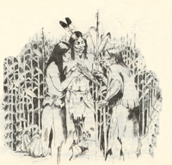
Haudensaunee- Use of Land
Haudenosaunee communities consisted of several long, bark covered structures called long houses. These cylindrical buildings often up to 200 feet long housed entire families all linking back to one common female ancestor. There were no locks on doors or really any doors other than flaps of hides. Stealing was nonexistent as the moral shame of it was enough to keep anyone from trying.
The Haudensaunee were not nomadic and farmed and hunted from permanent homes called longhouses.
http://www.haudenosauneeconfederacy.com/foodandfarming.html

Slide 5
Anishinabe- Role of Women
What where the roles of Anishinabe men?
Men were the hunters, and protectors for the Anishinabe people. They also went to meetings and taught boys how to hunt.
What where the roles of the Anishinabe women?
The Anishinabe women cooked, made clothing, and gathered food like berries.

Slide 6
Anishinabe- Roles of Women Continued
Women:
Anishinabe woman were considered the powerhouse of the family. They were full of energy and willing to work hard to help their families prosper and grow. The women were appreciated for being female and their role in nurturing their families through love, spiritual strength, food preparation, cleanliness, and making clothes. They were resourceful and appreciated for their contributions toward the family, band, tribe.

Slide 7
Anishinabe- Use of Land
The Anishinabe were a nomadic people. They would move their wigwams into the forest in winters to use the trees as shelter from the wind and snow. The animals also retreat to the woods where they can find protection from the elements and nourishment from the vegetation that can grow underneath the forest’s canopy.
In Spring and Summer the Anishinabe people would move their settlrments tothe riversand lakes to take advantage of the fishing and animal herds that would also flock to the fresh water sources.

Slide 8
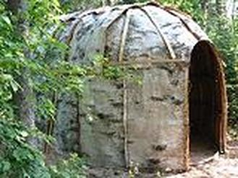
Anishinabe- Use of Land Continued
The Anishinabe lived in Wigwams a half walnut shaped hole with a smoke hole in the top they were made with poles deep in the ground and were usually covered with cattail rushes, basswood bark, and birch bark.
The wigwam was easily taken down and relocated to allow the Anishinabe people to move with the seasons.
They used toboggans and snowshoes to travel through the snow. This technology allowed themto relocating easier during the change of seasons.

Slide 9
Mi’maq- Role of Women
http://www.muiniskw.org/pgCulture2g.htm

Slide 10
Mi’kmaq- Use of Land
The Mi’kmaq were nomadic like the Anishinabe First Nations. They took advantage of the the migratory and spawning habits of fish, mammals, and seabirds.
http://www.heritage.nf.ca/articles/aboriginal/mikmaq-land-use.php

